Slide 1
- 072 - A little-known tag with a powerful impact on search and discovery. The National Library Service’s (NLS) customization of otherwise unutilized MARC tag to increase automated book selection for blind and print-disabled patrons, to speed up on-demand regional libraries’ circulation services, and to improve direct search and discovery in the NLS Catalog.
by Anita Kazmierczak, Head of Bibliographic Control Section,
National Library Service for the Blind and Print Disabled,
Library of Congress
October 2023

Slide 2
Presentation abstract:
072 MARC tag otherwise known as a Subject Category Code (LC) or Broad Descriptors (NLS) has been used by the National Library Service to first and foremost build a genre/subject bridge between the NLS Catalog and NLS BARD database, in recent years NLS started to publicize and expand the Broad Descriptors code list and utilization in MARC records. The little-known codes become an important key in the process of a patron’s book auto-select and become an effective support tool to optimize NLS Catalog search and discovery. This presentation will describe how in just a couple of years 072 tag became one of the most interesting and helpful coded MARC tags that can relate and collaborate with searches across different MARC and non-MARC databases, how it can simplify on-demand patron search in regional libraries across the United States, and how it directly relates to readers and librarians high demand interests and topics. How the 4-letter codes filled the space between Library of Congress Subject Headings and Local Public Libraries themes and reader’s direct interest genres. How the 072 MARC tag can potentially consolidate three aspects of the library’s search and discovery: vocabulary control and standardization, local demand, and reader preference.
Keywords: MARC, access, discovery, tag 072, subject headings, broad descriptors, genres headings, Library of Congress Subject Headings, LCSH, subject category code, NLS, accessibility, reader auto-select, bibliographic description,

Slide 3
072 Subject Category Code Repeatable
Definition and scope:
Code for the subject category that is associated with the described item.
Repeated for multiple subject category codes.
Code for the subject category that is associated with the 1XX field in an established heading record or a node label record.
Subject Category Code Source Codes
https://www.loc.gov/standards/sourcelist/subject-category.html
*bisacsh = BISAC Subject Codes

Slide 4
072 and 65X compliance – examples
072
65X

Slide 5
NLS take on 072 – how we got here
1. 072 – Broad Descriptor or NLS Subject list was created to accommodate specific but somewhat limited network libraries reader auto-select search and selection. 072 became linked to BARD search criteria.
2. 072 – (before 2021) tag initially complied only with 655 MARC tags (genres)
3. 072 – (2020/21/22) expended to add international language codes (mainly for Marrakesh Treaty titles and growing NLS foreign language collection) – ongoing as the collection grows and more languages are added to it
4. 072 – (2022) expended to add popular topics based on public demand and patron search behavior, start to comply with 655 and 650 tags to reflect LCSH in the 072 field
5. 072 – (2022 winter) become searchable, and all codes are linked as a part of NLS Catalog OPAC modernization, the list became public and is available for download to all NLS/LC users and patrons
6. 072 – (2022 winter) NLS learned that public libraries highly if not exclusively rely on 072 to create an auto-select reading list for patrons across the country
7. 072 – (2023 summer) further expansion planning to include many more genres and topics including everyone’s favorite COZYAF code to the list
8. 072 – (2024) list will include more age groups to better categorize target audience within genre and topic
https://nlscatalog.loc.gov/vwebv/ui/en_US/htdocs/help/docs/NLSSubjects.pdf

Slide 6
NLS Broad Descriptors/NLS Subjects [072 _ 7] - I
LANG
2022
LANG
LANG
LANG
LANG
LANG
LANG
2023
2022
LANG
LANG
LANG
LANG
LANG
LANG
LANG
LANG
LANG
2022
LANG
LANG
LANG

Slide 7
NLS Broad Descriptors/NLS Subjects [072 _ 7] - II
LANG
LANG
LANG
LANG
LANG
LANG
LANG
LANG
LANG
LANG
LANG
LANG
2022
LANG
LANG
LANG
LANG
LANG
2023
2022
LANG
2022
LANG
LANG
LANG
LANG
LANG
LANG
LANG
LANG
LANG

Slide 8
NLS Broad Descriptors/NLS Subjects [072 _ 7] - III
LANG
LANG
2023
LANG
LANG
LANG
LANG
2023
LANG
LANG
LANG
LANG
LANG
LANG
LANG
LANG
LANG
LANG
LANG
LANG
LANG
LANG
LANG
2023
LANG
LANG
LANG

Slide 9
072 Subject codes in the NLS Catalog – DISPLAY
Available to the PUBLIC
NLS CATALOG
072 matrix

Slide 10
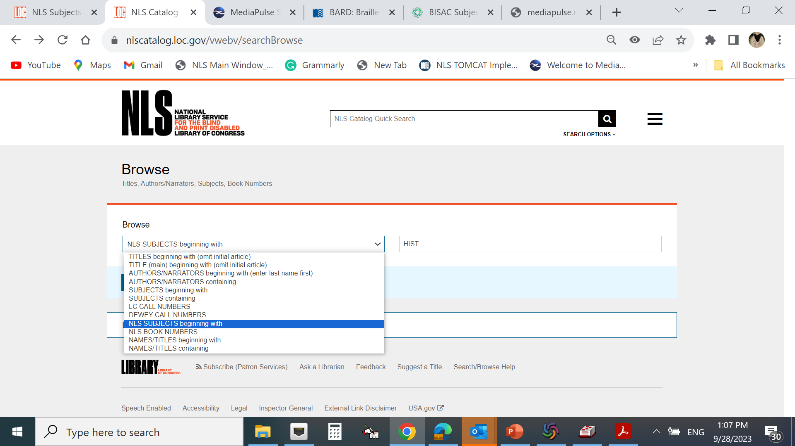
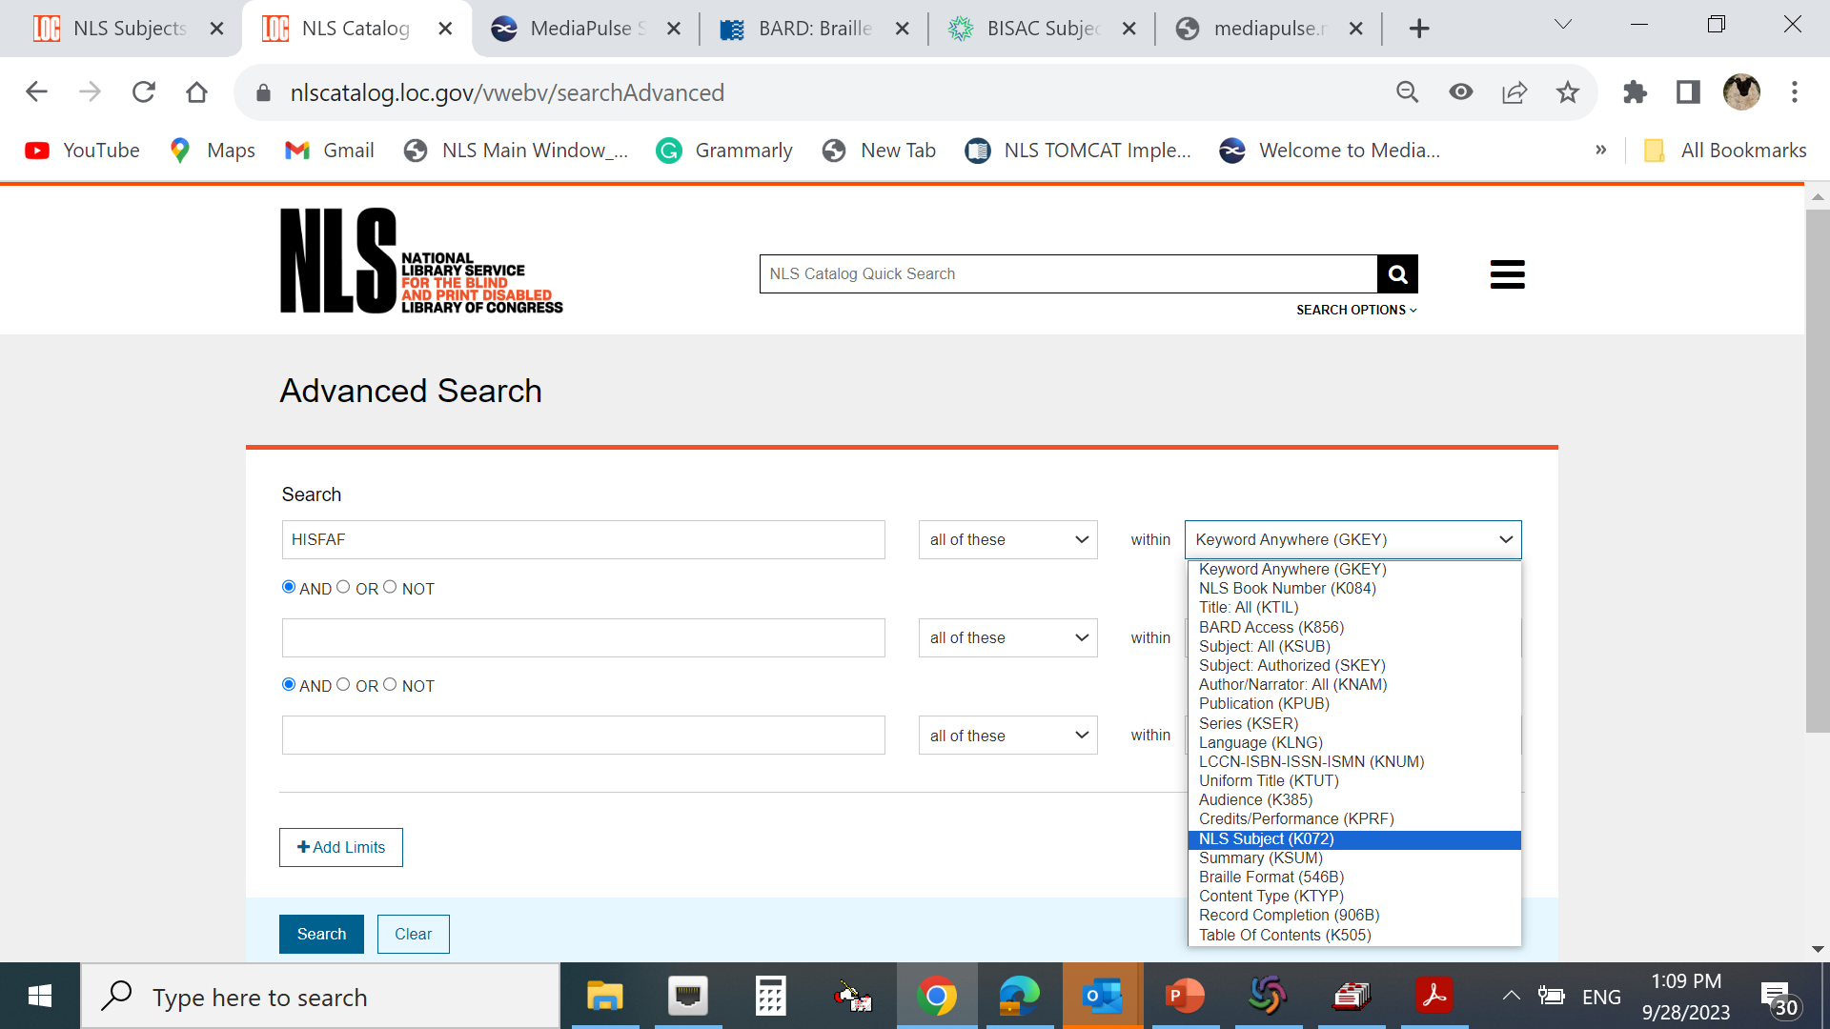
072 Subject codes in the NLS Catalog – SEARCH
Available to the PUBLIC
NLS CATALOG

Slide 11
072 Subject codes in BARD – SEARCH

Slide 12
072 Subject codes in BARD – DISPLAY

Slide 13
072s are coded versions of LCSH (650)
072
072s linked in BARD to preloaded search criteria
072s are indexed in the
OPAC to be it’s own
linked search category
072s linked by circulation vendors and network libraries to the reader’s auto-select profiles
072s are coded versions of the LC genre headings (655)

Slide 14
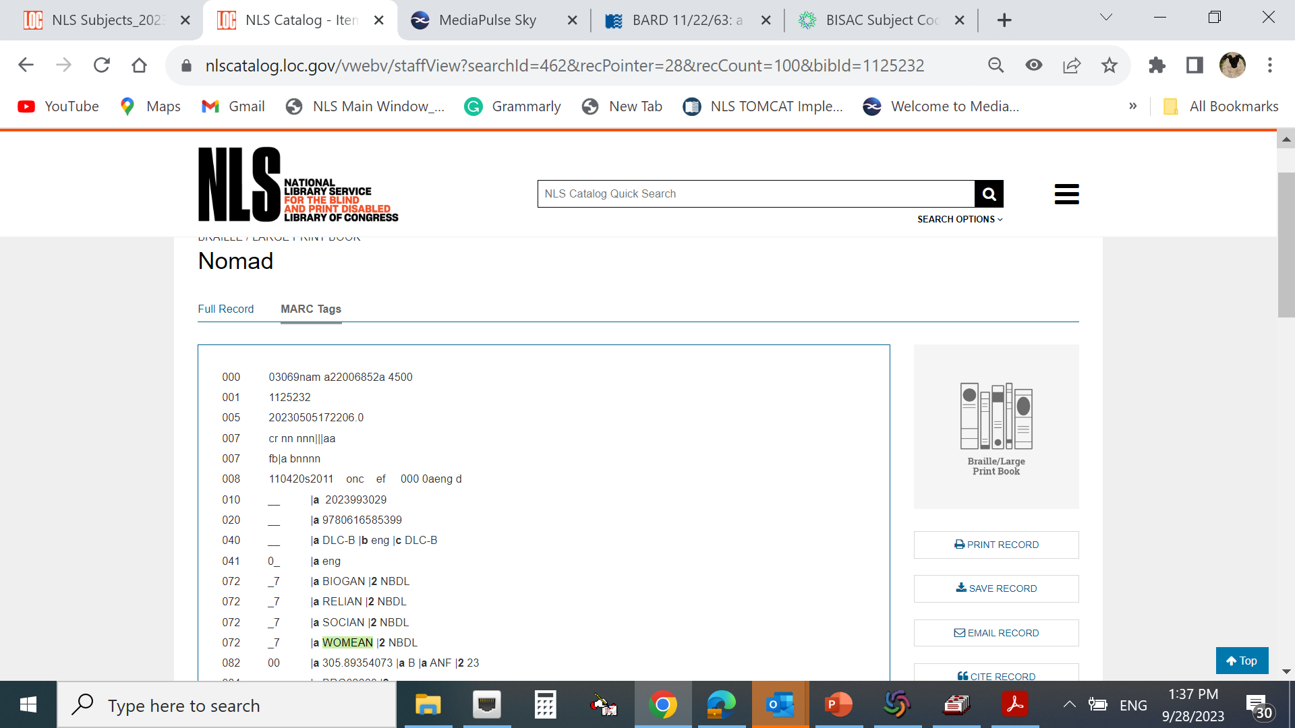
NLS 072 deconstructed
072
* Indicators
1st none
2nd “7”
* Subfields
$a Subject category code 4 LETTER
Audience and genre code 2 LETTER
AF – Adult Fiction
AN – Adult Nonfiction
JF – Juvenile Fiction
JN – Juvenile Nonfiction
$2 Source code $2 NBDL (NLS source code)

Slide 15
What’s next for 072
-- To further ease public library programs for blind and print-disabled Auto-Select system NLS will add new codes to the NLS Subjects list. Expanding it by the most popular book genre and topics to endorse users’ personal reading preferences e.g.
- Fiction with Dogs (DOGSAF/JF)
- Fiction with Cats (CATSAF/JF)
- Travel Fiction (TRAVAF/TRAVJF)
- Knitting and knitters
(KNITAN/JN/AF/JF)
- Farm and farming
(FARMAF/JF/AN/JN)
- Feminist Fiction (FEMNAF/FEMNJF)
- Bilingual Books
(BILIAF/ BILIAN/BILIJF/BILIJN)
-- As we add new codes the search criteria on BARD will be expended as well.
-- NLS Subject codes will be part of the linked search resources in the upcoming new Library (on NLS Collection only) discovery platform (2024).
-- Collection Division of NLS would like to add another age preference for the Young Adults (YF/YN) category to the existing: Adult and Juvenile.
-- NLS Subject Source code $2 NBDL will be added to Subject Category Code Source Codes https://www.loc.gov/standards/sourcelist/subject-category.html
We are happy to share the NLS Subjects list.

Slide 16
Thank you for listening Happy cataloging!
Contact:
Anita Kazmierczak email : ahoffman@loc.gov

