Slide 1
Visualization as sensemaking, or, Seeing the forest and the trees
Gina Solares, University of San Francisco
PTPL Annual Meeting 2018
Notes:
Good morning! And thank you all for being here today. What a great keynote to start us off, thank you Rebecca! And thanks to the PTPL board and Meeting organizers for putting this event together. We’ve got an exciting program and I’m honored to be speaking here today.
I really love these kinds of gatherings -- technical services folks getting together for some shop talk. Who brought the ‘How many reference librarians does it take…’ jokes? Just kidding! I know many of us are doing reference, instruction, outreach, liaison work, and lots of other tasks on top of our acquisitions, cataloging, systems and collections management work. I am not here to tell jokes at my colleagues expense, rather I’d like to talk to you today about how you can use visualization as a means to engage in a process of sensemaking with your colleagues.
Rebecca gave us a great overview of assessment, a variety of methods and approaches, and the importance of assessment in advocating for technical services. I’d like to speak a little bit about how the process of gathering and visualizing your assessment data, or any data really, can be a sensemaking process for your organization, whereby staff throughout the library can see concretely the benefits, gains, and improvements you’re making in technical services.

Slide 2
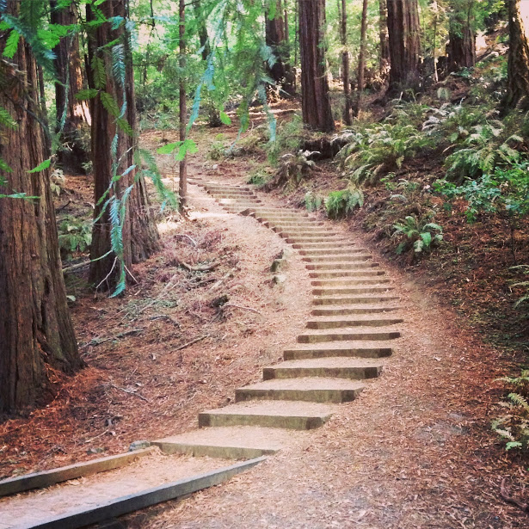
Overview of my talk today:
Why visualize
Visualization as sensemaking
Project case studies using Tableau Public, Piktochart, & draw.io
Some resources and tools for getting started
Notes:
So to do that, my plan for this talk to to share a little bit about
Why we might want to visualize
How visualization can be a process of organizational sensemaking
A few Visualization projects from my library
Some resources and tools for you to get started
This talk stems from a need at my library to improve and increase communication across library units. After making a few simple experimental visualizations, which I’ll share with you today, I kicked off a collaborative project to visualize our acquisitions, cataloging, and systems infrastructure. What began as an exploratory process ended up strengthening our understanding of our current setup, including constraints, gaps, and redundancies. We also were able to use this infrastructure chart to communicate beyond technical services, identify budgetary needs, and show our connection to the student experience. I hope that by sharing with you the simple visualizations that I’ve created, you’ll see opportunities for doing work like this in your own libraries.

Slide 3
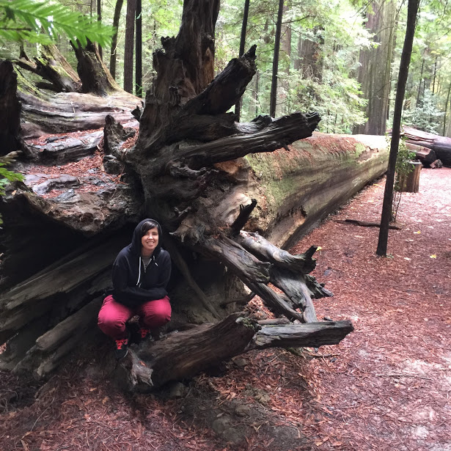
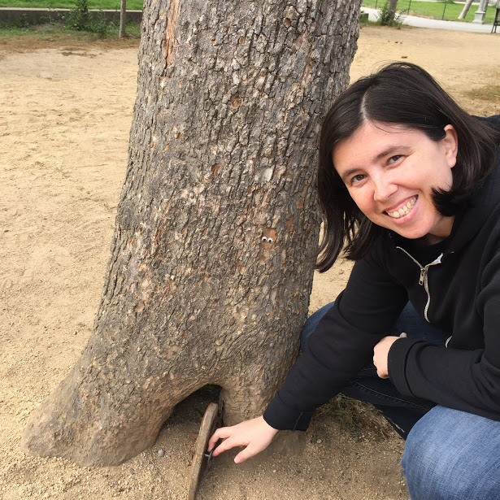
Notes:
But first, Introductions! As you know from today’s program, my name is Gina Solares. I live and work in San Francisco, and I love the ocean, the redwoods, and the fog. I’ve only lived in Northern California for a few years and I’m enjoying all of the natural beauty of the region. That’s me in the roots of a downed redwood, and me opening up a fairy door in a tree in Golden Gate Park.

Slide 4
Notes:
I am currently the Head of Cataloging and Metadata Management at the University of San Francisco. I am also serving as Interim Head of Library Systems, and I suspect that dubious honor is due primarily to the retirement of a colleague and my willingness to talk so much about our technical services and systems infrastructure. So I guess the subtitle of this presentation could be, how I made a chart and talked myself into a second job as Interim Head of Library Systems. But I digress. Before coming to USF, I’d worked in art libraries for most of my career. Regardless of the type of library that I’ve worked in, my focus has always been in technical services, so I have a great deal of love for the kinds of collections work we do on a daily basis.
And I’d like to preface my talk today by saying that I’m not an expert, I’m not a whiz with the viz, I’m just a librarian who who has struggled to understand and communicate complex technical issues and workflows. At my library, I created a few simple visualizations and was able to use those visualization in a variety of communication settings. I’m going to talk about those projects today and about the some of ways that using visualizations changed my communication strategies with colleagues in the library and at the University.

Slide 5
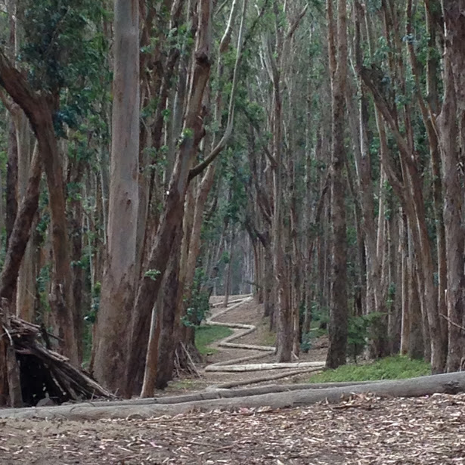
Visualization as sensemaking, or, Seeing the forest and the trees
Some examples...
put data in context
summarize data
show relationships
show step by step processes
Notes:
The title of my talk today is “Visualization as sensemaking, or, Seeing the forest and the trees” So what do I mean by that? Well, I’ve become convinced that creating visualizations at work can highlight and aggregate individual expertise into a more clearly defined collective vision around where you are and where you’re going at your institution.
So why focus on visualization as a sensemaking tool? Well, in technical services, we regularly deal with lots of information, and are especially skilled in organizing, classifying, and interpreting data. When we work with metadata, we are not only focused on details, but we’re also keeping in mind how this data fits in to the larger catalog, database, or information landscape. We’ve got a mental map of how this data fits together, but we don’t often explicitly make the larger picture visible. Visualization can help us sketch out and present a framework for that bigger picture.
For some examples, visualization can be used to
Put data in context
Summarize large sets of data
Show relationships
And show step by step processes

Slide 6
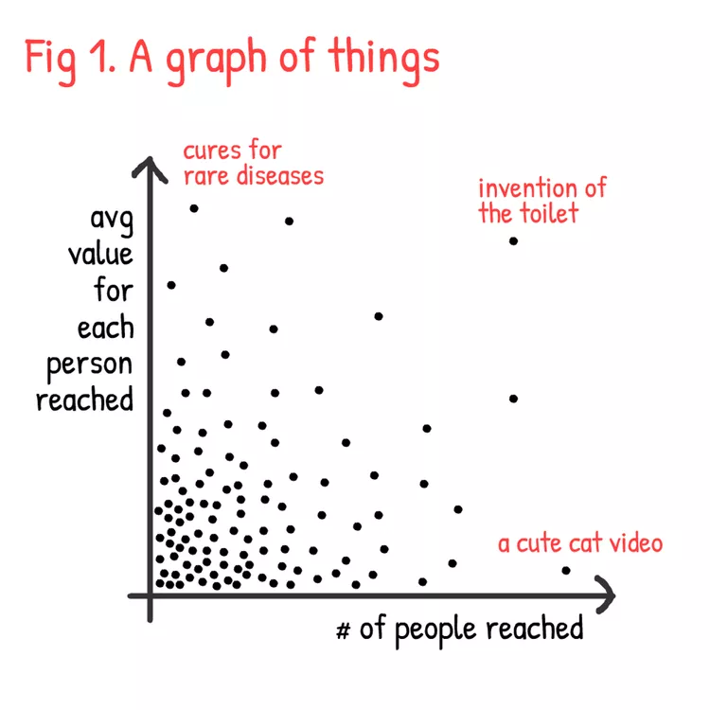
Visualization can put data in context
Nicky Case
A Graph of Things
Notes:
put data into context
Nicky Case’s A graph of things - Each dot represents a thing someone made. One one axis we see the number of people that it reaches and on the other we see the value of that thing for each person reached. So we can see here that cures for rare diseases don’t reach many people, but they have a great value for each person reached. On the other hand we have a cute cat video that reaches a lot of people, but perhaps is not of immense value for each person reached. Debatable, though, right? Although, put into a context with cures for rare diseases, that probably makes sense.

Slide 7
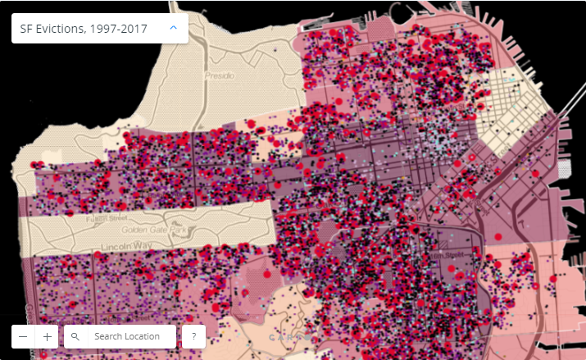
Visualization can summarize large sets of data
Anti-eviction mapping project
Notes:
summarize large sets of data
All SF Evictions, 1997-2018
All San Francisco evictions from 1997-2017, by the Anti-Eviction Mapping Project

Slide 8
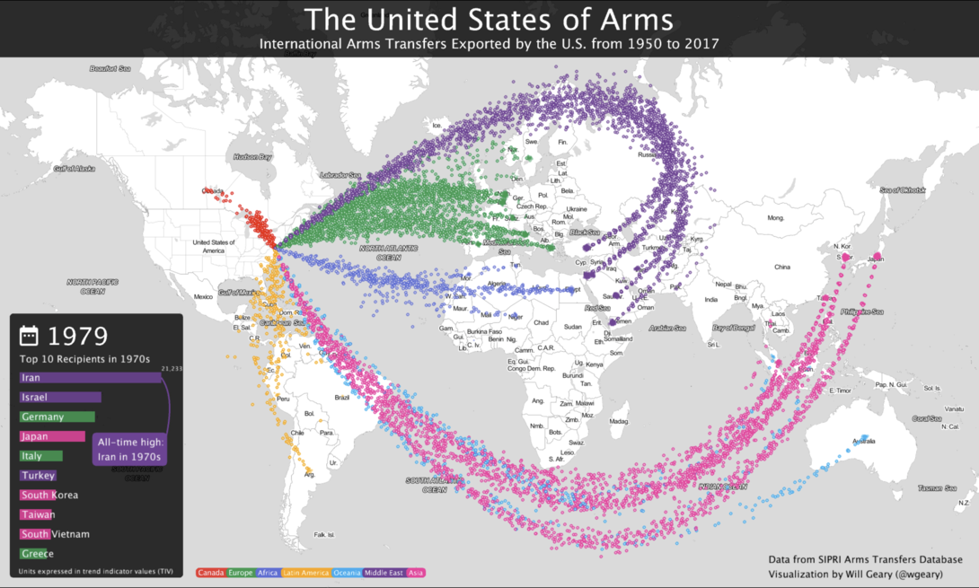
Visualization can show relationships
Will Geary
United States of Arms
Notes:
Show relationships
United States of Arms by Will Geary
visualizes U.S. major weapons exports from 1950 through 2017.
The underlying data comes from the Stockholm International Peace Research Institute's Arms Transfers Database, a free and publicly available dataset which tracks the global arms trad

Slide 9
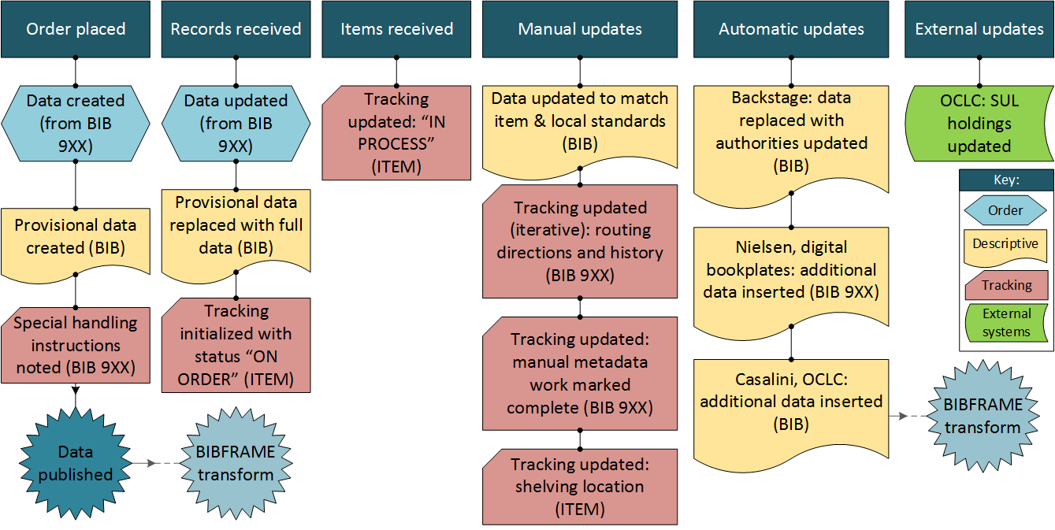
Visualization can show step by step processes
Marc workflows, Stanford LD4P
Notes:
step by step processes
Overview of existing MARC workflows From Stanford’s linked data production project
There are lots of other ways we can use visualization but these four seem especially relevant to the kinds of needs we might have in libraries.
Put data in context
Summarize large sets of data
Show relationships
And show step by step processes

Slide 10
Notes:
The visualizations we make can be interesting to look at, but I’d argue that it’s the process of collecting the information, sifting through the details, and communicating with our colleagues to create and confirm collective meaning that can be most useful within our library.

Slide 11
Sensemaking in organizations
active exploration [data collecting]
labeling & categorizing [info organization]
sharing what we know to build collective understanding
Coined by Karl Weick, prof of Organizational Behavior & Psychology at University of Michigan Business School
Notes:
That process of creating collective meaning has been called organizational sensemaking.
This kind of sensemaking is a process that involves active exploration, information gathering, organizing and labeling what you’ve collected, with the purpose of building collective understanding and purpose. Communication and collaboration is key to this process.
In technical services, we gather, collect, aggregate, and organize information all the time. But the real impact is in how we communicate that information and create meaning. How do we use information about tech services, our collections, or our workflows to engage with our colleagues and explain, inform, investigate, and advocate for the work that we do?
Karl Weick, a professor of Organizational Behavior and Psychology at the University of Michigan Business School has been studying organizations for decades and the ways that organizations engage in sensemaking.

Slide 12
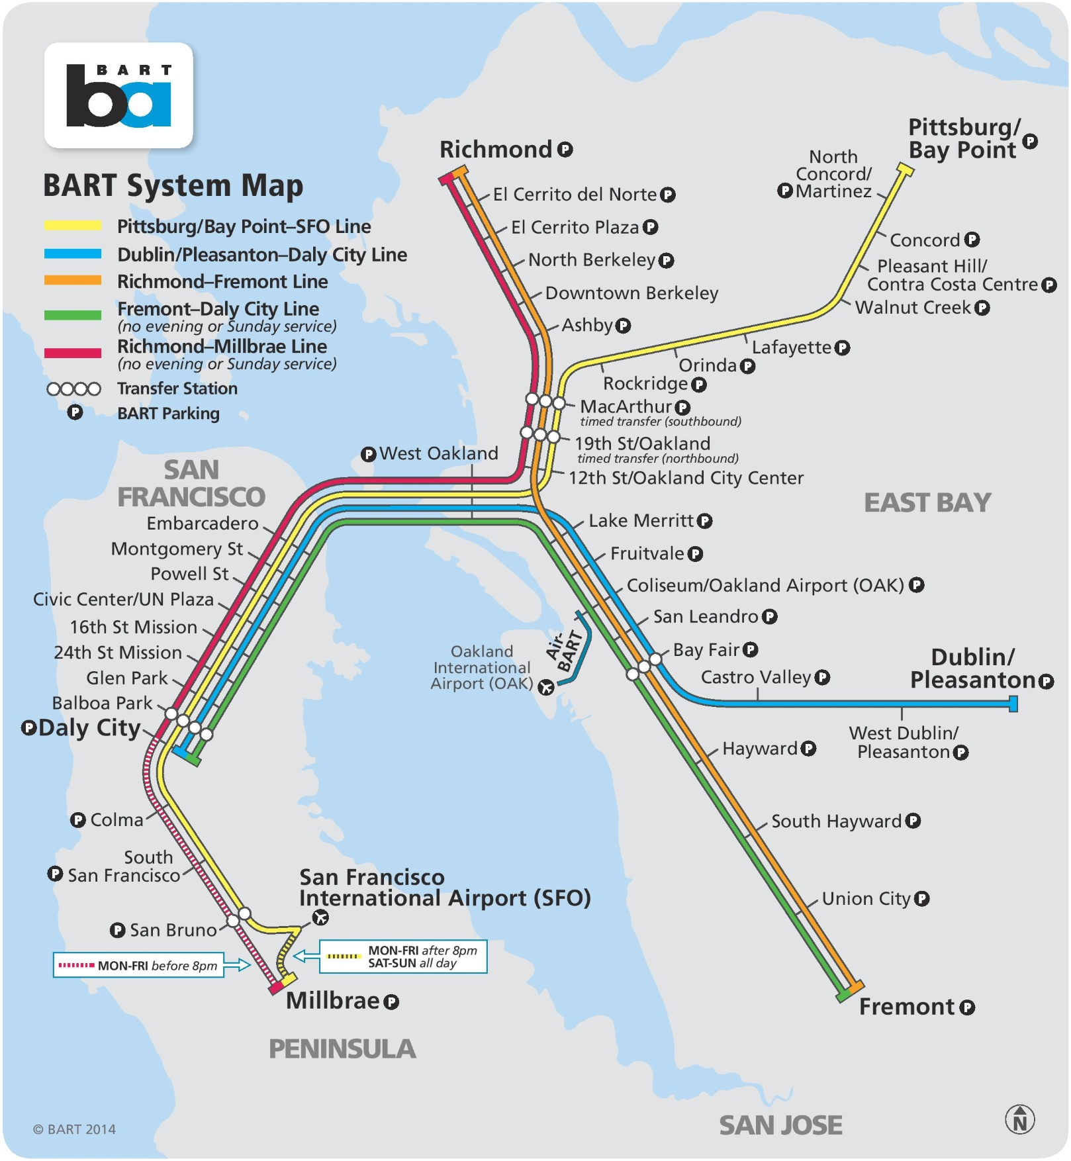
sensemaking is the “transformation of raw experience into intelligible world views. It’s a bit like what mapmakers do when they try to make sense of an unfamiliar place by capturing it on paper.”
Notes:
One of the definitions of sensemaking that I particularly like, is that sensemaking is the “transformation of raw experience into intelligible world views. It’s a bit like what mapmakers do when they try to make sense of an unfamiliar place by capturing it on paper. …”
https://hbr.org/2003/04/sense-and-reliability
Of course, our libraries are not completely unfamiliar places, but there are often gaps between work done in different units and it’s that larger picture that we sometimes cannot see while we’re engaged in the details of our individual work. Sensemaking can help us all see the same map of our work instead of seeing only from our own perspectives.

Slide 13
Notes:
Okay, I’m going to switch gears a little bit and bring this back to my library.
I’d like to share with you a couple of visualization projects that I created. They are fairly simple, which I hope will be encouraging to those of you in the audience who might consider doing something similar. But I hope to show that it’s the process of making these visualizations and working with colleagues that can have an impact in your library.

Slide 14
University of San Francisco fast facts
55 acres / 10,000 students
500K print books & 500K ebooks
45 library staff
16 in technical services
7 Acquisitions
4 Cataloging & Metadata
5 Systems
Notes:
For a little context: USF is a private, Jesuit University with a primary campus located on 55 acres in the heart of San Francisco. We enroll about 10,000 students, with the majority in undergraduate arts and sciences. Gleeson Library is probably a relatively small operation compared to some of the places where you work. Collections wise, we’ve got approximately half a million print books and the same (500K) ebooks. Our students primarily use databases and other electronic resources via our Discovery service. We’ve got about 45 full time staff with 16 of those staff members in 3 distinct units in Technical Services.

Slide 15
Assessment
Technical Services program review (2014)
Gleeson Library program review (2016)
Notes:
In 2014 we had an external review of our technical services. That included self study reports written by each unit, on-site interviews and recommendations from an external reviewer. In 2016, we did a full program review of Gleeson Library, again comprised of self study reports from each unit in the library, a site visit and recommendations from external colleagues.
There were at least two notable similarities in these two assessment processes.

Slide 16
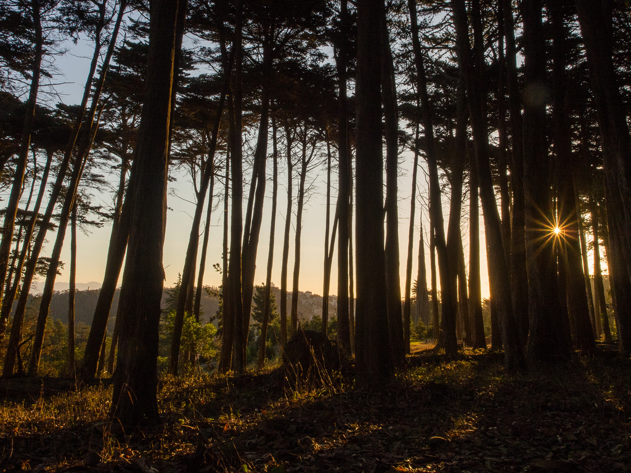
Similarities:
1. Department self studies did not generally identify a need for change
2. Many wanted more communication from other departments
Notes:
One, Departments wrote their self studies in isolation, and after describing workflows and successes, often concluded that things were fine in their department and that no changes were necessary
And two, many departments suggested that there was not enough communication in the library and that they’d like to know more about what was happening in other units.
So in response, I was looking for creative ways to communicate information from the cataloging department, and I was looking for ways to identify and make visible the places where we might be able to improve workflows. From the self study reports, it seemed like those places might be in the gaps between departments, the workflow handoffs, and maybe even in seeing that bigger picture.
So that’s what led me to try visualization.

Slide 17
But why visualize?
No one reads your emails. You write these really great emails, outlining complex issues, highlighting opportunities, and making recommendations. And then you get no response. You cannot even be sure the anyone has ever read what you’ve written. And honestly, blocks of texts aren’t getting us anywhere. I mean, you and I, we like to read blocks of texts. Books, am I right? But most people, when they’re trying to cross stuff off of their to-do list, cut the budget, meet those deadlines -- they don’t want to read big blocks of text, no matter how eloquently written. So you can write the most wonderful prose showing how our work has meaning, how it fits in with the work done in other departments, and how it is absolutely essential to the functioning of the library, but it probably won’t be read. Or at least won’t be read with the level of care that you put into writing it. So, why not make a chart, or a picture, or an infographic? You might find that it’s more persuasive and memorable than that long email or that annual report or that budget justification that’s taken you all day to write.
Notes:
I decided I needed a visual aid to help me understand our technical services environment & to be able to communicate that clearly to others.
If you’ve ever sent a beautifully written, detailed email to a colleague and gotten a one-word response, you also might be interested in visualization.
In response to the feedback about communication from the program reviews, each department started sharing department meeting notes with all staff. I’ve heard the rumor that some people find cataloging kind of boring, so i wanted to include some visual elements in my department notes. I saw those department communications as an opportunity to educate, and to tell stories about cataloging that were interesting, compelling, or at least seen as relevant to others in the library.

Slide 18
Tableau
Business Intelligence & Analytics
Good for big data sets
Suggests visualizations based on data formats
Free browser based version: Tableau Public, but your viz will be accessible to the public online
Notes:
So initially I turned to Tableau.
Because when I think of visualizations, I think of big sets of data and the kinds of summary vizzes that can bring new insights based on your data. Tableau is known for business intelligence and analytics, it’s good for big sets of data, it has a helpful suggestion option once you’ve loaded some data into it, and there is a free browser based version named Tableau Public, so I didn’t have to pay up front or download any software.
Note that ** When you work with data in Tableau Public, the viz is accessible by anyone on the internet, so be sure to only use data that is suitable for a public audience.**

Slide 19
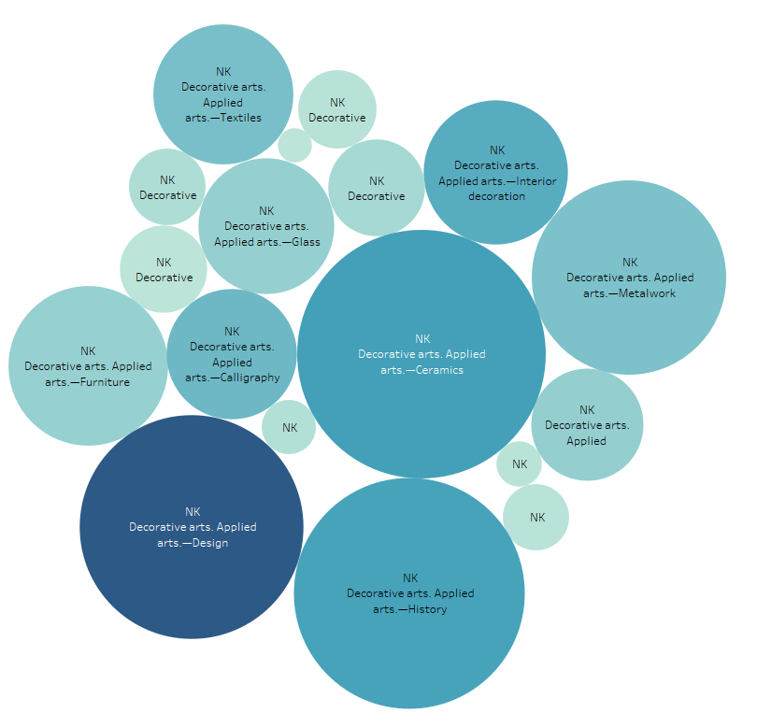
Collection analysis Packed bubble chart
Represents books classed in NK - Decorative arts
Bubble represent amount of books
Intensity represents usage
Notes:
For me, I had a mixed experience with Tableau. It wasn’t so much the capabilities of the software, as it was the messiness of the data I was trying to visualize and a lack of purpose in my visualization. This was meant to be collection analysis of the LC class NK at my library - showing relative subclass size and usage -- the darker colored bubble there, representing books classed in Applied Arts - Design circulated more than books classed in Metalwork. Perhaps it’s surprising that we seem to have more books classed in Ceramics than in Design, but these packed bubble charts are difficult to use for analysis and other than being sort of fun to look at, they aren’t very useful.

Slide 20
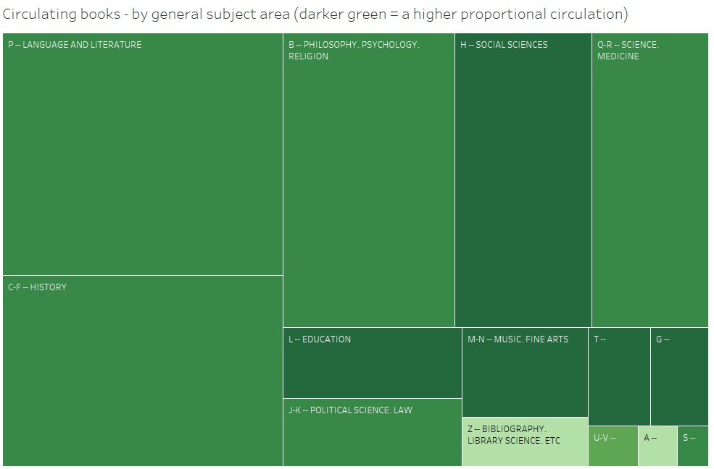
Collection analysis Tree map
Books by LC main classes
Intensity represents usage
Notes:
My playing around with Tableau also led to this basic treemap showing relative size of subject areas (by LC class number), overlaid with a heat map showing 'proportional circulation' -- the darker colored boxes had a higher percentage of items that circulated at least once.
The analysis did not reveal much that we didn’t already guess about the collection -- we have a lot of books classed in the Ps (literature), C-F (history) & B (philosophy & religion), and people are checking out more books in social sciences with makes sense for us, and they’re checking out fewer books from the As and Zs.
What I learned out of this experimentation is that visualizing collection data takes an immense amount of time in the clean up and organization of your data. I had output data from my marc records, so you can imagine the kinds of data cleanup projects I found and you can imagine my dithering around creating intelligible categories based on LC Class number groupings.

Slide 21
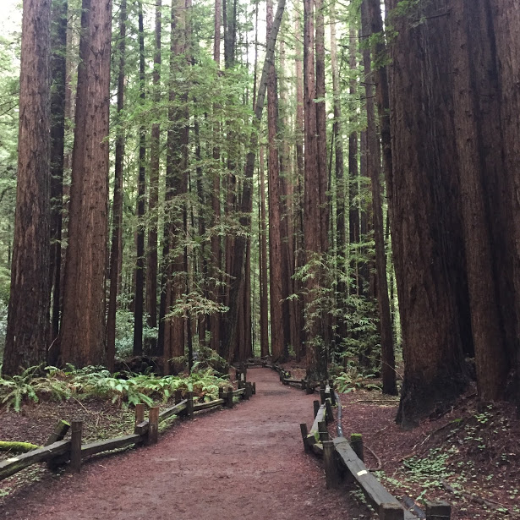
“Before tackling which data to present, take a few minutes to decide what you want to say … consider the exact message you want to communicate. Ask yourself, “What do I know, what does it mean, and why do I believe it’s important?”
DATA +DESIGN : A simple introduction to preparing and visualizing information
Notes:
The bigger issue though was that I didn’t have a clear purpose or audience for these visualizations. They were good learning experiences, but they weren’t great communication devices.
“Before tackling which data to present, take a few minutes to decide what you want to say … consider the exact message you want to communicate. Ask yourself, “What do I know, what does it mean, and why do I believe it’s important?”

Slide 22
Piktochart
Free basic version
Nothing to download
Simple templates and icons
Subscribe ($) for advanced templates & features
create infographics, flyers, posters, presentations using themed templates
Notes:
Next up, I tried an web app called Piktochart, which claims to help you “create beautiful infographics and visuals easily with absolutely no design experience.”
huzzah, that’s me! :) Tableau’s suggested visuals were helpful, but Piktochart templates are an additional level of support for the beginner.
This time around, I decided to start with just a few bits of data. Unlike my first examples with tableau where I was attempting to shove large portions of data into a viz, here I just focused on a couple of very simple numbers.

Slide 23
Productivity Infographic
Materials delivered to circulation from cataloging
Notes:
I included this infographic in one of those department communications I mentioned earlier.
The bar chart that looks like mayo, mustard & ketchup highlighted the number of books we sent out into circulation each month with the numbers below comparing the same period from the current year to the previous year. I was attempting to communicate productivity of the department and make some of that regular work more visible to colleagues.
In the grey portion of the infographic, I’m showing new items added to the collection by location, represented for some reason as small circles of varying colors.
This infographic generated quite a few responses. Not, I think, because of it’s a very successful visualization, but I think part of the reason was that the information it conveyed was timely and affected multiple departments. Sparking communication and interest in the work of the cataloging department was a desired and gratifying outcome.

Slide 24
Notes:
For my next viz with piktochart, I wanted to build on the staff engagement I created with the previous infographic. I was working on an assessment of catalog features such as Virtual Shelf Browse, Tags, Other Editions, Ratings, and Reviews. I’d pulled usage data but I also wanted to get some feedback from library staff.

Slide 25
Notes:
So I made a small SurveyMonkey questionnaire to poll my colleagues on how often they used the library catalog & whether they found the catalog enhancements useful (included Other Editions feature, Virtual Shelf Browse, Tags, Ratings, Reviews, etc.). SurveyMonkey can provide charts based on survey responses, I haven’t found them to be very useful.

Slide 26
Survey Results
Number of responses by department
Notes:
I used a Piktochart template and put together a report of the survey results so that I could communicate back to respondents.
So here we’re looking at number of responses by department.

Slide 27
Notes:
This survey generated a lot of conversation. My colleagues were eager to talk about which features they liked and which were confusing or unknown to them.

Slide 28
Survey Results
Rating of features by familiarity and ‘usefulness’
Notes:
In this chart, we’re seeing ranked features, with the ‘Other Editions’ and ‘Virtual Shelf browse’ getting the most useful responses at the top here. And Ratings & Add a Review at the bottom.
Again, the visualizations aren’t terribly sophisticated, but it was the process of talking with my colleagues, gathering data, and then talking with them again that had the biggest impact. We learned about these features together, and when we made the decision to remove some of these enhancements it was clear that we were interested in what our colleagues had to say about these features.

Slide 29
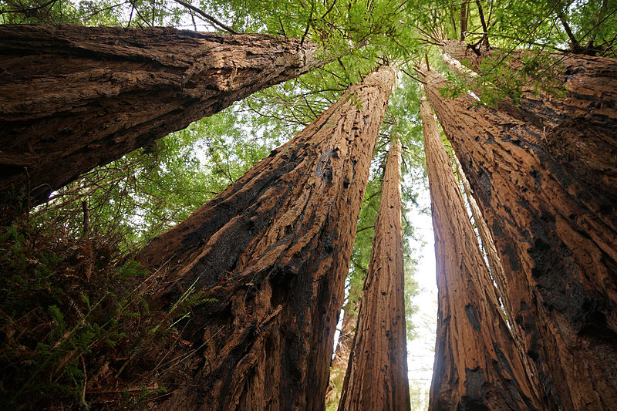
“translating information into visuals is now easy ... One drawback, though, is that it reinforces the impulse to “click and viz” without first thinking about your purpose and goals.”
Notes:
Again, I want to emphasize the importance of thinking about why you’re visualizing something. You might be just exploring your data, or you might want to use your visualization or infographic or diagram to communicate -- in which case you want to pause and consider your goals.
“Thanks to the internet and a growing number of affordable tools, translating information into visuals is now easy (and cheap) for everyone, regardless of data skills or design skills. This is largely a positive development. One drawback, though, is that it reinforces the impulse to “click and viz” without first thinking about your purpose and goals.” Visualizations That Really Work by
Scott Berinato

Slide 30
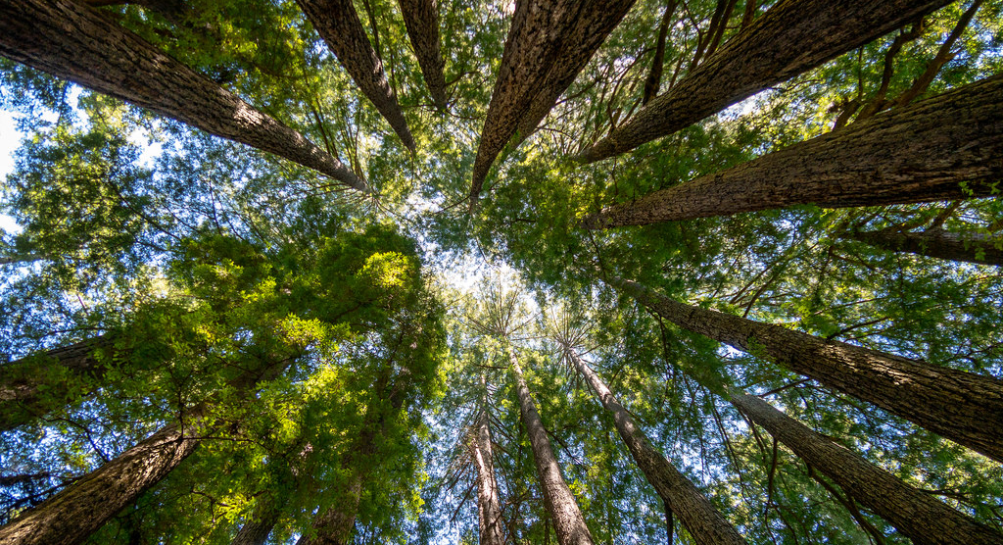
Notes:
So after I had tested the waters and had some mild success communicating technical services projects through visualizations, I knew I wanted to get back to looking for ways to identify and make visible the places where we could improve workflows. From those self study reports I mentioned earlier, it appeared that those places for improvement might be in the gaps between departments, in workflow handoffs, and in seeing the bigger picture.
So I started this next visualization project to help me figure out what the bigger picture looked like in technical services. If our departments - acquisitions, cataloging, and systems were each more or less saying that things were fine -- were there ways to demonstrate that we had some gaps between our departments or some broken connections in our workflows?

Slide 31
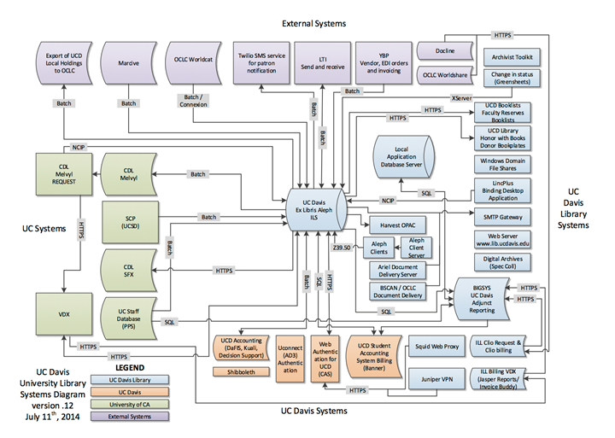
UC Davis Library Systems Diagram
BIBFLOW Project Update
Notes:
I was inspired in this work by the great UC Davis Library Systems diagram presented by Carl Stahmer as part of the Bibflow project at UC Davis. I had seen his workflow presentations and wanted to be able to create something similar to use in my library.
I started by drawing a chart. I had been reading Carson Block’s LITA Guide to Managing Library Technology and in it they write:
“Oh, in a pinch, chart paper and markers can do, and blank paper and a pencil (with a good eraser) are almost as good. But a large erasable surface (and markers --especially a variety of colors) is one of the most powerful ways to check one’s own logic and understanding, troubleshoot, build ideas as individuals or teams, and communicate those ideas during the present and into the future.” -- Carson Block. Managing Library Technology: A LITA guide (p. 16)
Since I knew I wanted to collaborate and knew that I’d be moving things around on the diagram as I went along, I decided to turn to a software solution. That’s when I found draw.io

Slide 32
draw.io
Free & open source
PDF export
Browser based, no software to download
No watermarks or draw.io branding
Plug in to Google Drive (& others)
Notes:
I was pretty sure that Tableau and piktochart were insufficient for this project. I needed something that would help me create diagrams and wouldn’t lock me into a predefined template. I wasn’t sure what my visualization would look like when I finished it, and I wasn’t sure how to use draw.io, but I thought I’d give it a shot.
USF is a G Suite campus, and draw.io can be used via a google drive plugin, so I didn’t have to worry about additional logins, where the files were stored, etc. and I could play around without a lot of additional pressure.
Draw.io
Free, browser based, simple
Open source, developed by JGraph Ltd.
PDF export
No watermarks or branding on your final chart or diagram
As I mentioned it can integrate with Google Drive.
And can be integrated with Confluence (team collaboration) and JIRA (software development & bug tracking)
There are other options for charting / workflow diagramming (Lucidchart) This is not an ad for draw.io, but I found it easy to start using & easy to play with so I wasn’t worried about spending a lot of time learning a tool only to find that it would not meet my needs.

Slide 33
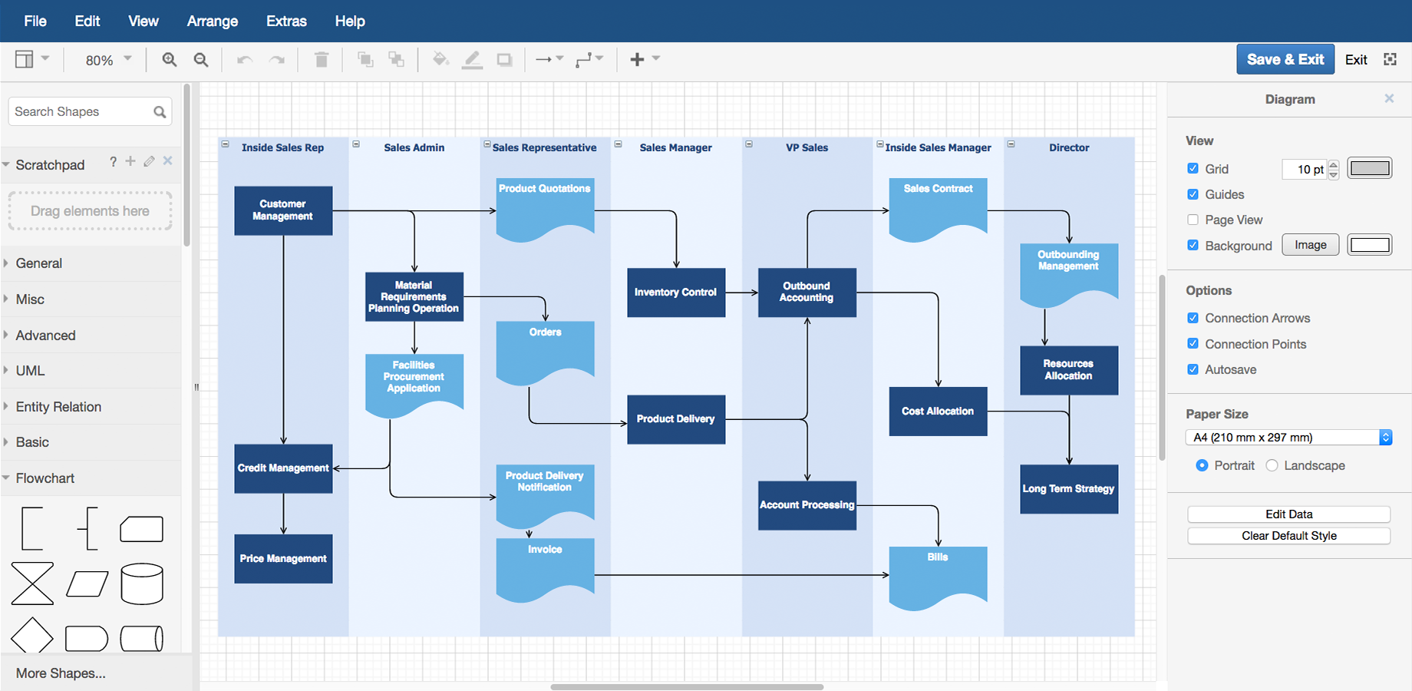
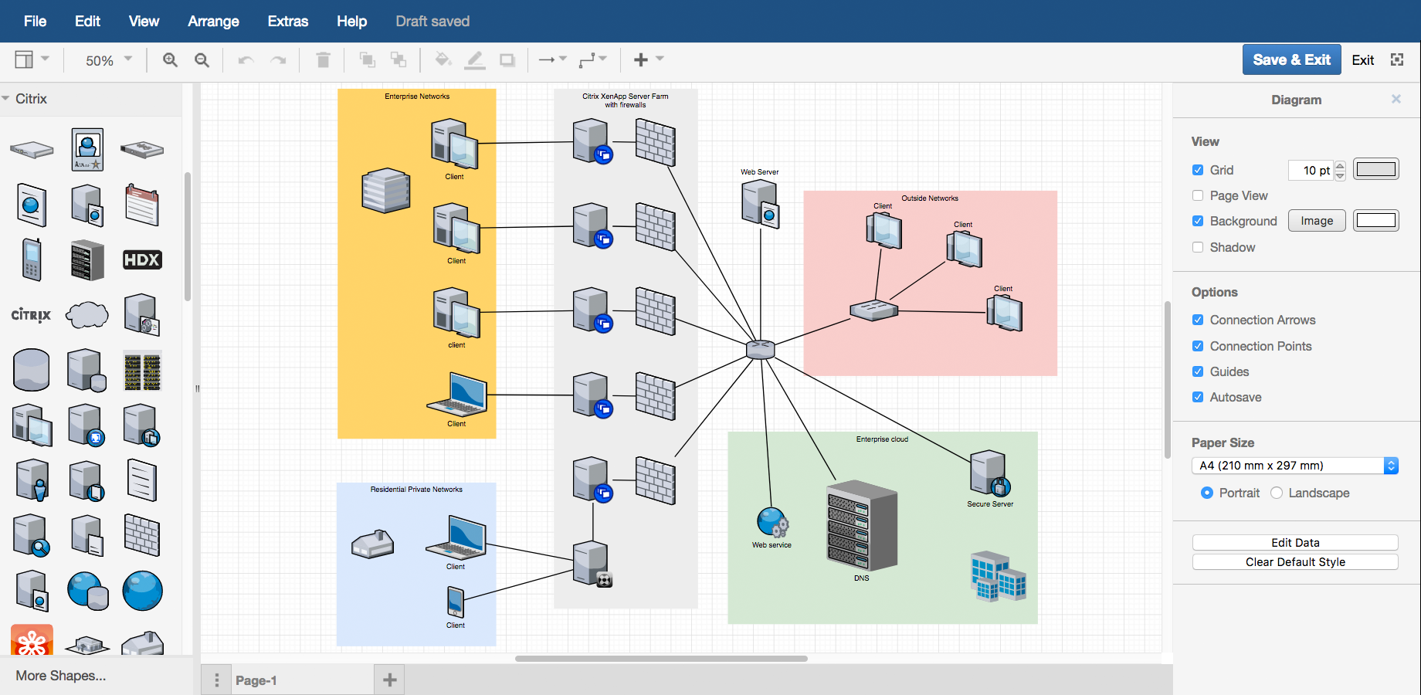
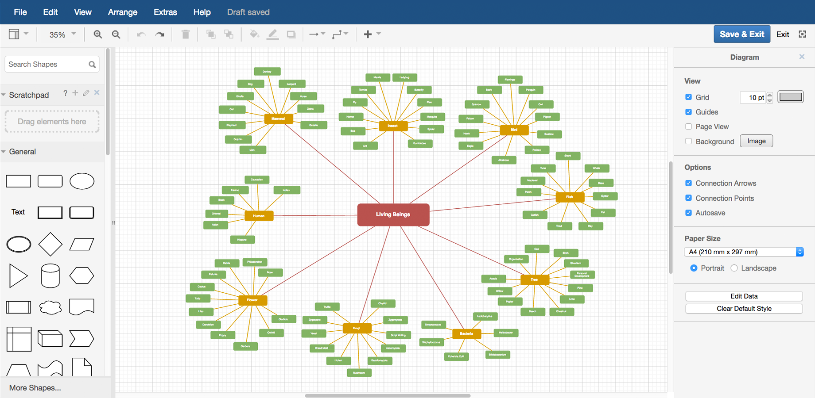
about.draw.io/features/examples
Notes:
I took a very simple approach to using draw.io, but there are many sophisticated ways to use it, including customizing the chart templates or creating more advanced diagrams such as gantt charts, mindmaps, network diagrams, venn diagrams, and more.
Draw.io also offers a wide range of icons, fonts, and shapes as well as tutorials, exercises, cheat sheets & a video training series.

Slide 34
Goals of the project
Identify key systems & connections
Clarify internally what we call our systems
Reveal weaknesses or redundancies
Demonstrate a connection to the patron experience
Show how our work is connected
Communicate our central role in library operations
Notes:
Before I started the visualization, I spent some time thinking about my purpose and goals. I made a list of process goals and communication goals. I hoped this visualization could
Identify key systems & connections between them
Clarify internally what we call our systems
Reveal weaknesses or redundancies in our workflows or systems
Demonstrate a connection to the patron experience
Show how our work in technical services and beyond is connected
Communicate technical services’ central role in library operations

Slide 35
Notes:
I was convinced that in making this chart we could promote the idea that technical services plays a central role in library operations, one that is not just in the back room, but directly connected to the student experience and one whose complex, interlocking parts are not easily decoupled.

Slide 36
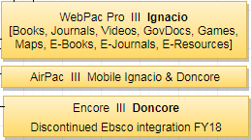
Chart making (a completely unscientific approach)
Notes:
So I started visualizing our technical services infrastructure by making a list and representing known components in boxes in my chart…. As the head of cataloging, I started with Sierra & I made that box really big. Then I added OCLC & made that pretty big, too.

Slide 37
Goal: Identify key systems & connections
Notes:
Then, because one of my goals was to Identify key systems & connections between them, I just started building out from that.
The catalog is more than just the catalog of course, and so I added the “other” parts of the ILS & their public facing components. So the yellow boxes in my chart were Triple I modules like Web Access Management, Course reserves, or Decision Center.
And OCLC is more than just cataloging services, so I added the “other” parts like Resource Sharing (ILL) & Digital Collections (ContentDM), which for us are also powered by OCLC services.

Slide 38
Identify key people & connections
Notes:
To expand my chart, I reached out to my colleagues. I knew I wanted to be able to engage my colleagues in conversation to clarify what we call things and to engage in some sensemaking. By sharing workflows and processes, we started to create an awareness of the bigger picture.
I reached out to colleagues individually, in person, and online and asked them questions. What do you think of this chart? What’s missing? And is this how you’d show the connection between these parts?
These conversations helped to identify new elements to add to chart & new connections that I didn’t know about.
For example, we had weeding procedures in periodicals that included a notification to cataloging to update holdings, but we realized there was a gap in notifying eresources, who had loaded print holdings into our Journal Finder. By asking questions about how each department was using a particular system, we identified places where we could improve our workflows.

Slide 39
Goal: Clarify internally what we call things
Functional name: library catalog
Product name: WebPAC
Branded name: Ignacio
Notes:
The communications I had with colleagues also helped with another goal. In internal conversations, it was clear to me that we were using different words to mean the same thing, or parts of the same thing. Some departments were using a functional name, while others were using the product name or the USF branded name. This made troubleshooting difficult, and we weren’t doing ourselves any favors by commingling the interfaces on our website.
In making this chart, and grouping those ‘names’ together, we were able to Clarify internally what we call things. It may seem like a small thing, but this was huge. I was able to point to this chart and say “no, I’m talking about this other piece over here, or yes, we’re talking about the same thing.”
When I talk about the library catalog, do I mean Sierra / WebPAC / Ignacio / Encore / Doncore ?
Ebsco’s Full Text Finder (FTF), Journal Finder / Holdings and Link Manager (HLM), Link Resolver

Slide 40
Goal: Reveal weaknesses or redundancies
Notes:
Another goal in this process was to Reveal weaknesses or redundancies which are also opportunities for integration & improvement. We kept writing self studies claiming that we were doing just fine and there were no opportunities to improve. I wanted to test that assertion.
I knew already that we were running two discovery layers side by side, and that we weren’t managing the content in the same way in each interface. So we looked at our processes for managing data in our various patron facing interfaces. There were places where we were definitely pushing and pulling data more than we needed to because we were supporting multiple discovery systems. Since then, we’ve cancelled EncoreDuet and are now only running one discovery system.
In addition we recently created the position of User Experience/Web Design Librarian to do some assessment of our public interfaces so that we can have a more data driven approach to where we’re putting our efforts.

Slide 41
Goal: Demonstrate a connection to the patron experience
Clear discovery options
Impact on students
Notes:
There’s a lot of conversation on my campus about showing the connection between your work and the student experience. So I wanted to show that the work done in technical services is directly connected to the student interaction with the library. To Demonstrate a connection to the patron experience in the chart, I organized our “back end systems” on the left and connected them to the patron facing interfaces on the right.

Slide 42
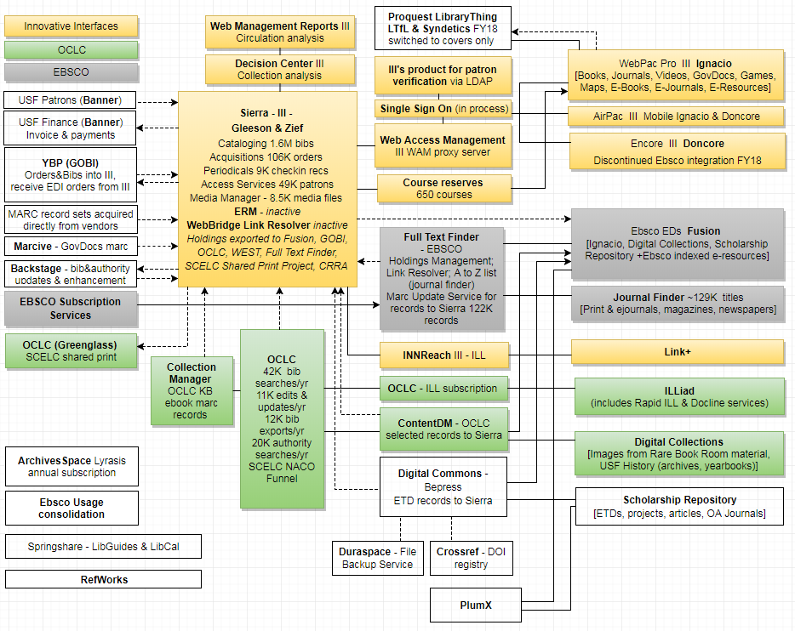
Goal: Show how our work is connected
(or where it could be more tightly joined)
Notes:
Another goal I want to mention is showing how our work is connected. This came up time and time again in the conversations we had about this chart. We used dotted lines where we had manual processes for data loading and identified opportunities for automation. I was able to use this chart to convince my boss that dotted lines meant more staff time spent pushing and pulling data. So, as my University planned its implementation of Workday, a new HR system, I was able to advocate for some IT resources to work on building APIs to load patron data for us. Thereby saving us staff staff and getting rid of the dotted lines.

Slide 43
Goal: Communicate technical services’ central role in library operations
Notes:
And I wanted to Communicate our central role in library operations
I’ve shown this chart to colleagues throughout the library, and it has been a powerful communication tool and visual aid -- this visual representation of the technical infrastructure of acquisitions, cataloging and systems reveals the complexity and effort that goes into technical services work. Even if our colleagues are still sometimes a little fuzzy on what exactly we do, now they can see a clear connection to the front end services that our work supports.

Slide 44
Unexpected
Outcome #1
Transparent systems budgeting
Notes:
I just want to mention briefly two somewhat unexpected outcomes of making this chart and working together with my colleagues to identify, name, and diagram these systems.
With the use of this chart, the library leadership team was able to compile and identify all of the budget items tied to these systems. They had previously been spread out in a number of budget lines, but we were able to consolidate our systems spending, making us much more effective in projecting our yearly increases and assessing our systems spending.
Also, we regularly had budget pressure to reduce our costs for Triple I & OCLC. I was able to demonstrate with this chart 1) that the costs were not just “catalog department costs” and 2) that the costs were directly tied to services that affected the student experience.

Slide 45
Unexpected
Outcome #2
Visual documentation of shared workflows and gaps
Notes:
had been hopeful that this process of communication and sensemaking would help us better understand where we had shared workflows across the library. The bonus in this process was that by creating this diagram, we made visual documentation of our understanding that we could refer back to, and we see quickly how small changes in one part of the operation may have big impact in another area.
I’m almost done here, thank you for patience as I walked through these fairly simple visualization projects. I want to stress the iterative nature of visualizing processes or systems.

Slide 46
Visualization as sensemaking
Collect data
Organize info
Share what you know
Listen & learn
… Together
Notes:
To continue to extract value from a chart this like this, you’ll want to repeat that sensemaking process with your colleagues --
active exploration & data collecting
naming, categorizing, and organizing your data or information
sharing what you know
And listening and learning together to build a common understanding

Slide 47
If you want to make a chart, some advice...
Start with what you know
If you want low tech, try a whiteboard
Talk to people about your chart & ask questions
Make adjustments as you get new information
Add stuff even if you’re not sure where it goes yet
Update when things change
Notes:
I just want to finish today by suggesting a few ways you could get started with a process like this:
Start with what you know
If you want low tech, try a whiteboard
Talk to people about your visualization & ask questions
Make adjustments as you get new information
Add stuff even if you’re not sure where it goes yet
Update when things change

Slide 48
Active exploration
Collect data
Ask questions
Observe
& Listen
Look for gaps
Notes:
If you don’t want to make a chart, but you want to brainstorm other kinds of visualizations, a good place to start is that active exploration step -- talk to your patrons, your library colleagues, ask questions, observe your library services, and listen. What data can you gather? How do workflows or resources fit together in your department? This context can help you create more meaningful visualizations. Even creating a visualization of your current state can provide a benchmark you can use in later assessments.

Slide 49
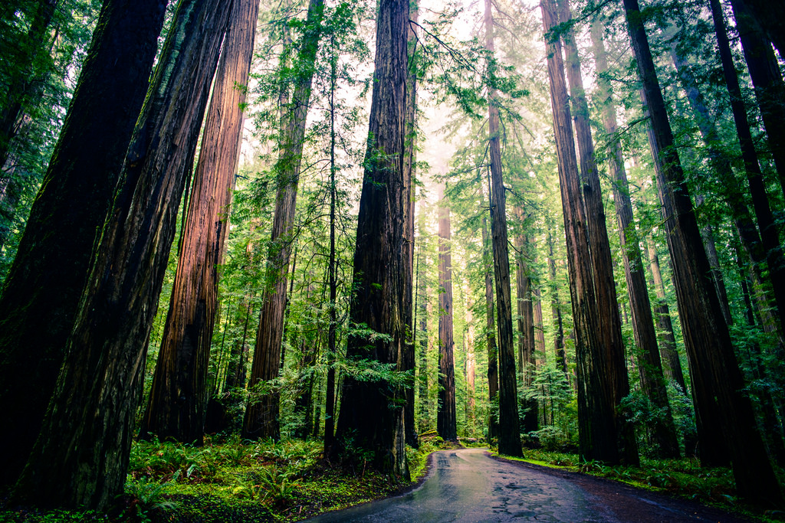
Organize your info: look for patterns, trends, rankings, surprising data, or connections
Notes:
Then organize what you’ve collected -- look for
Patterns
Trends
Rankings
Comparisons
Counterintuitive data
Relationships
Those might make good visualizations.

Slide 50
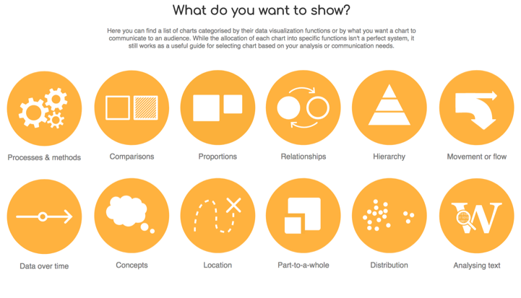
https://datavizcatalogue.com/search.html
Notes:
There’s lots of great advice, templates, and suggestions online about what kinds of visualizations work best depending on the type of data you have. Like tableau’s suggested visualization based on the format of data you’re using. Or tools like Data Viz Catalogue which provides suggestions based on what you want a chart to communicate to an audience: Comparisons, Proportions, Relationships, Hierarchy, Concepts, Locations, and more.

Slide 51
Tools
Notes:
You might consider using one of the tools I talked about today, tableau public, piktochart, and draw.io all offered a low barrier to entry, but there are lots of other options, including online apps like
Visme.co interactive charts, graphs and maps
Or the free & open source DIVE from MIT Media Lab, which promises semi-automated visualization and statistical analysis without having to code https://dive.media.mit.edu/
And I do want to inject a plug here really quickly for the upcoming ALCTS 2 part webinar on Intro to Data Visualization, it’s in November 7th & 14th and it will cover working with Tableau as well as a variety of other data analysis tools.

Slide 52
Inspiration
Notes:
And you can find lots of amazing data visualizations online, I’d recommend Visualizing data.com, Flowing data.com, and Information is beautiful.net, three sites that showcase and critique great visualizations.

Slide 53
Notes:
And my last bit of advice is to involve your colleagues in your visualization projects. The outcome will be far more meaningful and have more impact in your library.

Slide 54
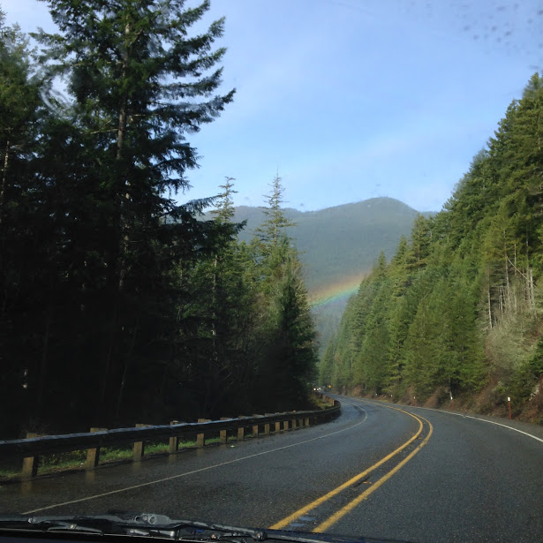
Thank you!
Gina Solares
gsolares@usfca.edu
Presentation credits: https://goo.gl/VagJcN
Notes:
Okay -- that’s enough from me. I’m happy to take questions or comments, and I hope we’ll have some time to chat over lunch about your visualization projects.
Thank you for your time today!

